Slide 1
Indexing-Basics

Slide 2
Locating Records: Table Scans
Select ID, name, address
From R
Where ID = 1000;
Naïve way ➔ Table Scan
Open the heap file of relation R
Access each data page
Access each record in each page
Check the condition
Data
Page 1
Header
Page
Data
Page 2
Data
Page N
DIRECTORY

Slide 3

Locating Records: Table Scans
Data
Page 1
Open the heap file of relation R
Access each data page
Access each record in each page
Check the condition
Header
Page
Data
Page 2
Data
Page N
DIRECTORY
Only 1 memory block
What is the least amount of memory needed for Table Scan?

Slide 4
Locating Records: Index Scan
Select ID, name, address
From R
Where ID = 1000;
Table Scan is always an existing option
But it is not efficient, especially for large relations
➔ Indexing & Index Scans are more efficient ways
  Depends on whether or not you have an index

Slide 5
Basic Concepts
Indexing mechanisms are used to speed up access to desired data.
Search Key - attribute to set of attributes used to look up records in a file.
An index file consists of records (called index entries) of the form
Select ID, name, address
From R
Where ID = 1000;
Search key
(search attribute)
search-key
pointer

Slide 6
Basic Concepts (Cont’d)
An index file consists of records (called index entries) of the form
search-key
pointer
Index files are typically much smaller than the original file
Types of indexes
  Dense vs. Sparse
  Primary vs. Secondary
  One-Level vs. Multi-Level

Slide 7
Index Evaluation Metrics
Savings here
Query time
Insertion time
Deletion time
Space (storage)
Access types supported. E.g.,
  Equality Search ( x = 100): records with a specified value in the attribute
  Range Search ( 10 < x < 100): records with an attribute value falling in a specified range of values.
Overheads here

Slide 8
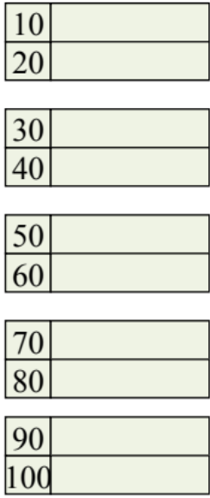
Sequential Files
& Primary Indexes
File where records are ordered on the indexed column

Slide 9
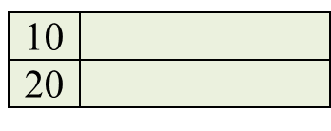
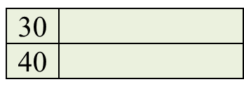
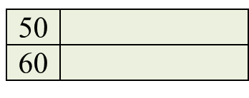
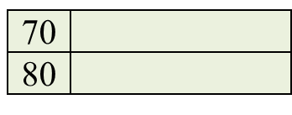
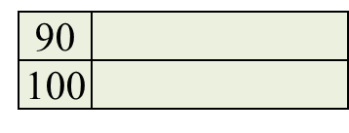
Dense Index on Ordered File
Dense Index
Sequential File
Ordered (Sequential) File
  Records are stored sorted based on the indexed attribute
Dense Index
  Has one entry for each data tuple
10
20
30
40
50
60
70
80
90
100
110
120

Slide 10
Dense Index on Ordered File
Dense Index
Sequential File
10
#entries in index = #records in file
20
30
40
50
60
But the index size is much smaller than the file size
70
80
90
100
110
120

Slide 11
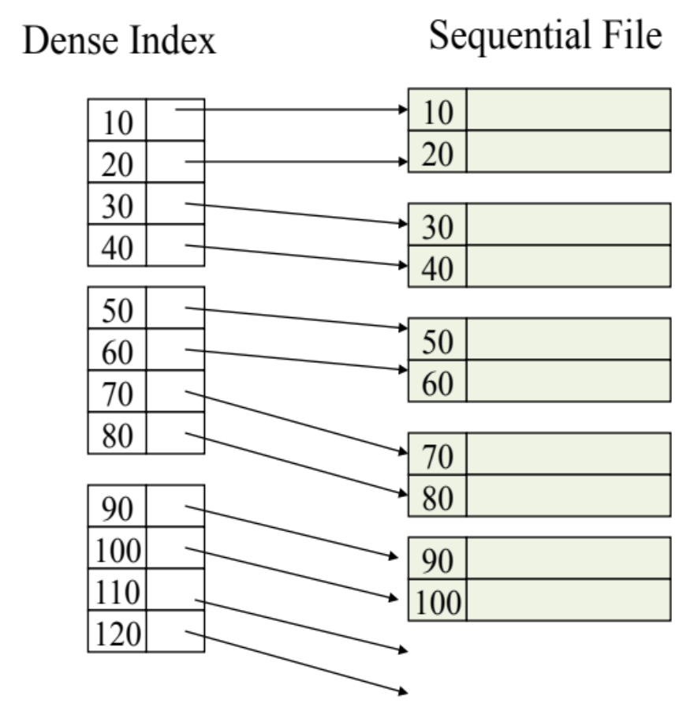
Dense Index: Locate Key = 100
Index Scan
  Read each page from the index
  Search for key = 100
  Follow the pointer ➔ (Record Id)
Index Binary Search
  Since all keys are sorted
  Read middle page in index
  Either you find the key
  OR Move up or down
Select ID, name, address
From R
Where ID = 100;

Slide 12
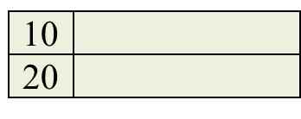
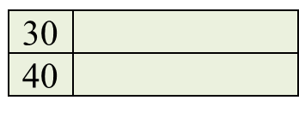


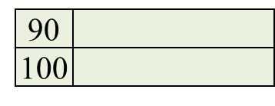
Sparse Index On Ordered File
Sparse Index
Sequential File
Sparse Index
  An entry for only the 1st record in each data block
10
30
50
70
90
110
Sparse Index is smaller than a dense index
130
150
170
190
210
230

Slide 13
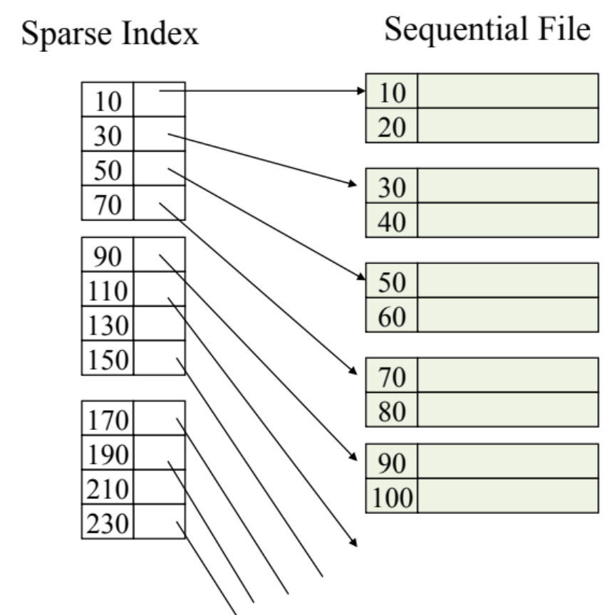
Sparse Index On Ordered File
Can we build a sparse index on unordered file?
Sparse Indexes can be built ONLY on ordered (sequential files)

Slide 14

Sparse Index: Locate Key = 100
Index Binary Search still works
Either locate the search key in the index, Or
Locate the largest key smaller than your search key
  Follow the pointer and check the data block

Slide 15
Multi-Level Index
Sparse 2nd level
1st level Index file is just a file with sorted keys
We can build a 2nd level index on top of it
10
90
170
250
330
410
490
Is the index file always sorted?
570
Is the 2nd level sparse or dense? Can it be dense?

Slide 16
Multi-Level Index
Is the index file always sorted?
Sparse 2nd level
10
Yes
90
170
250
Is the 2nd level sparse or dense? Can it be dense?
330
410
490
2nd, 3rd, … levels have to be sparse (otherwise no savings)
570

Slide 17
Sparse vs. Dense Indexes
Sparse
  Less space
  Better for insertion
  Only for sorted files (or higher-level indexes)
Dense
  More space
  Can tell if record does not exist without checking the data file

Slide 18
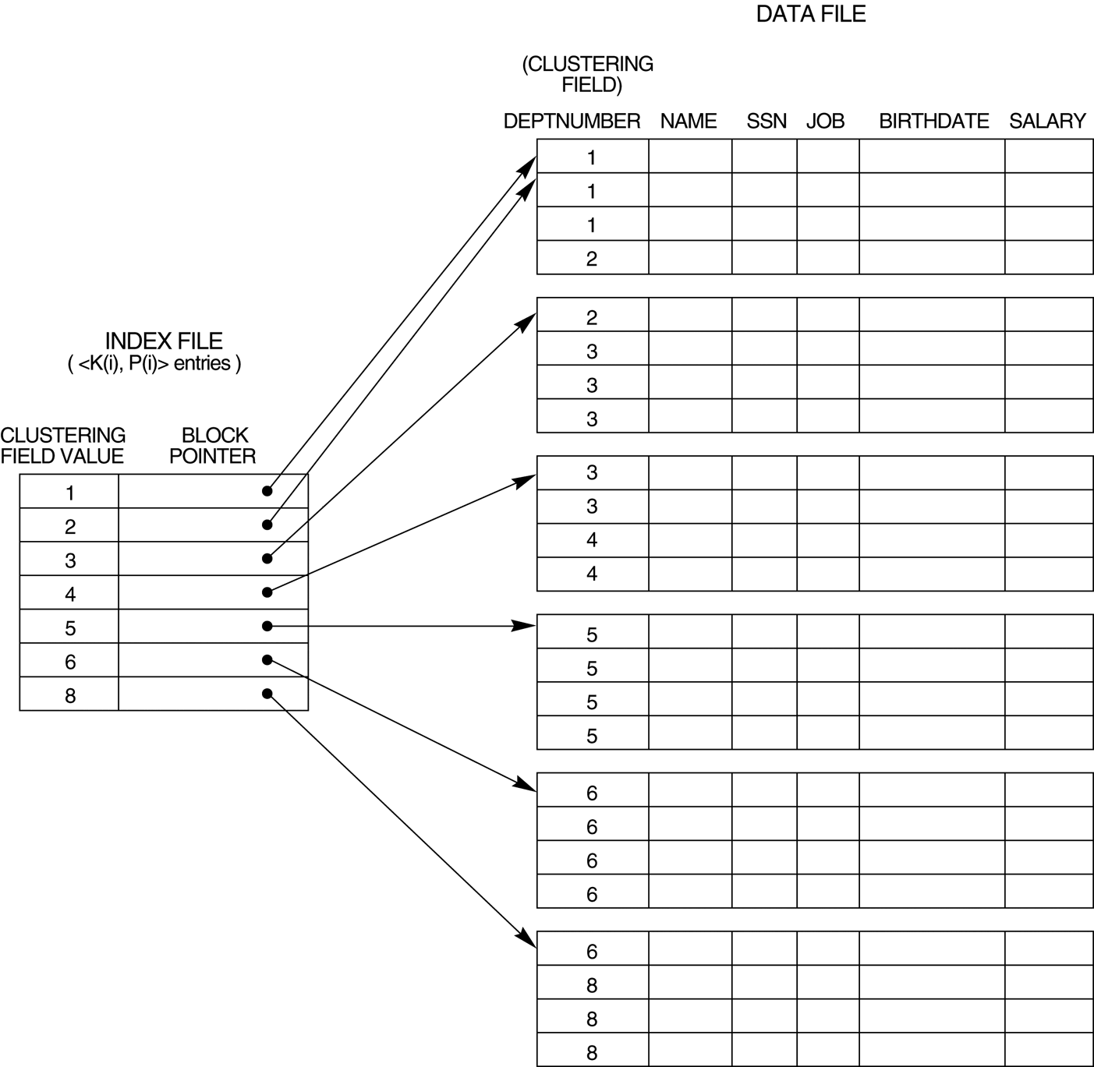
Remember…
Primary Index is:
  An index on the ordering column (the column on which the data file is sorted
  Can be dense or sparse
  Can be one-level or multi-level
Big Advantage
Records having the same key (or adjacent keys) are in the same (or adjacent) data blocks
Leads to sequential I/Os

Slide 19
Where does the data live?
Index files for a relation R can occur in three forms:
  Data entries store actual data for relation R.
    Index file provides both indexing and storage.
  Data entries store pairs <k, rid>:
    k – value for a search key.
    rid – rid of record having search key value k.
    Actual data record is stored somewhere else
  Data entries store pairs <k, rid-list>
    K – value for a search key
    Rid-list – list of rid for all records with key value k
    Actual data record is stored somewhere else

Slide 20
Clustered vs Unclustered Index
Index is said to be clustered if
  Data records in the file are organized as data entries in the index
  If data is stored in the index, then the index is clustered by definition. This is option (1) from previous slide.
  Otherwise, data file must be sorted in order to match index organization.
Un-clustered index
  Organization on data entries in index is independent from organization of data records.
  These are options (2) and (3)
File storing a relation R can only have 1 clustered index, but many un-clustered indices
  Why?

Slide 21
Clustered vs Unclustered Index
Suppose that Alternative (2) is used for data entries, and data records are stored in Heap file.
  To build clustered index, first sort the Heap file (with some free space on each page for future inserts).
  Overflow pages may be needed for inserts. (Thus, order of data recs is `close to’, but not identical to, the sort order.)
Index entries
UNCLUSTERED
CLUSTERED
direct search for
data entries
Data entries
Data entries
(Index File)
(Data file)
Data Records
Data Records

Slide 22
Back to Bigger Picture

Slide 23
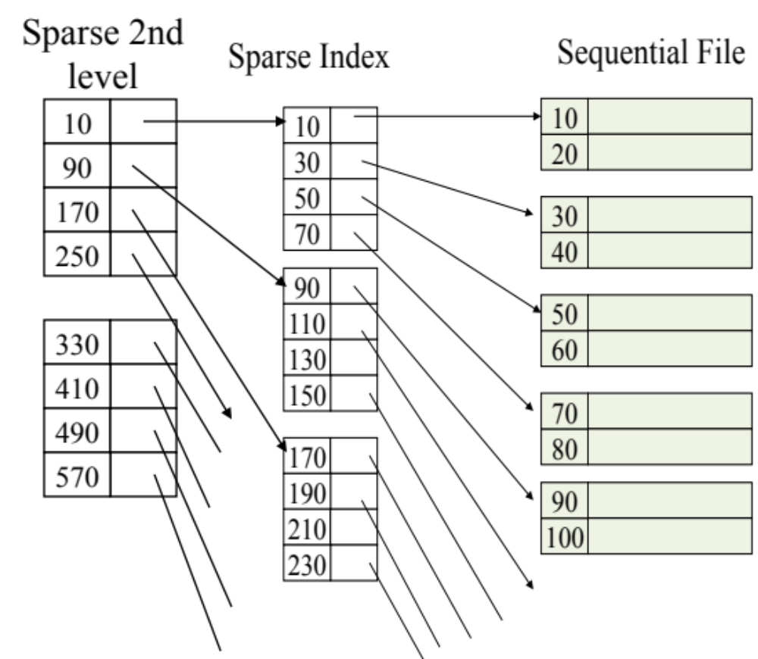
SQL Query
Select ID, name, address
From R
Where ID = 100;
Assume an index is built on column ID
2nd-Level Index heap file
R heap file
1st-Level Index heap file

Slide 24
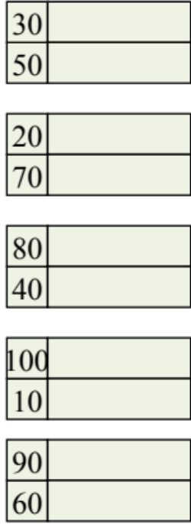
Un-Ordered Files
& Secondary Indexes
File where records are not ordered on the indexed column

Slide 25
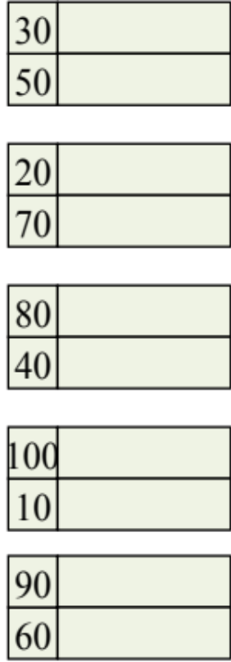
Secondary Indexes
Can we build a sparse index on un-ordered column??
No. We must have an index entry for each data record.
The file may be ordered on another column, say Name.
  An index on the Name column is primary index (Can be sparse or dense)
  An index on any other column, say ID, is called secondary index (has to be dense)

Slide 26
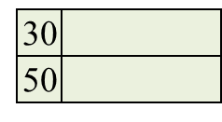
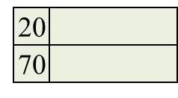

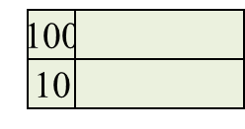
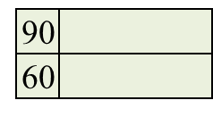
Secondary Indexes
Sparse index
30
20
80
100
90
...
does not make sense!

Slide 27

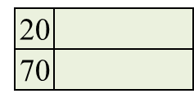
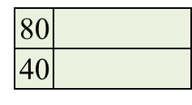


Secondary Indexes
10
20
An index entry for each data record
Pointers cause random I/Os (even for same or adjacent values)
30
40
50
60
70
...

Slide 28
Multi-Level Secondary Indexes
10
10
20
50
30
90
40
...
50
2nd-Level Index
(Sparse)
60
70
...
2nd level can be sparse because the 1st level index is a sorted file
Lowest level is dense
Other levels are sparse

